Slide 1
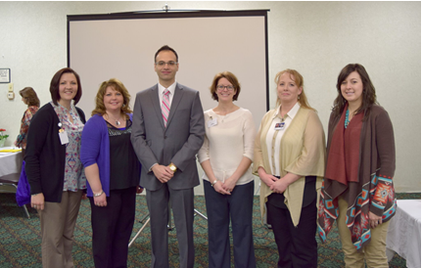
BARTON COUNTY HPV TEAM
Rachel Mawhirter, Great Bend Regional Hospital PR
Shelly Schneider, RN, Barton County Health Department
Dr. Anis Toumeh, Central Care Cancer Center, Liberal
Jamie Hutchinson, RN, Heartland Cancer Center, Great Bend
Leann Danner, RN, OCN, Heartland Cancer Center, Great Bend
Lexi Wright, Clara Barton Hospital PR
Not pictured: Devan Anderes, Central Care Cancer Center PR and Trish Martin, LPN, Clara Barton Hospital

Slide 2
PUBLIC EVENT
FLYER

Slide 3
CEU EVENT INVITATION

Slide 4
WELCOME
“Someone You Love” HPV Documentary & Seminar

Slide 5

SPONSORED BY
Midwest Cancer Alliance
The Midwest Cancer Alliance, also known as MCA, brings together cancer research, care and support professionals to advance the quality and reach of cancer prevention, early detection, treatment, and survivorship. MCA, the outreach division of The University of Kansas Cancer Center, links member hospitals, medical professionals and their patients with KU Cancer Center research and
services with so that the latest cancer research
and care can be accessed close to home.
www.MidwestCancerAlliance.org

Slide 6
DID YOU KNOW?
Random Facts About the HPV Virus
There are about a dozen high risk strains of HPV which can cause cancer.

Slide 7
DID YOU KNOW?
Random Facts About the HPV Virus
Thus far, no serious side effects have been shown to be caused by HPV vaccines. The most common problems have been brief soreness and other local symptoms at the injection site as well as fainting, and possible blood clots for those using oral contraceptives.

Slide 8
WELCOME
“Someone You Love” HPV Documentary & Seminar

Slide 9

SPONSORED BY
Heartland Cancer Center
Cancer treatment often requires a multi-disciplinary approach, which includes CHEMOTHERAPY and RADIATION THERAPY. Everyone at Central Care Cancer Center plays an important role as an active team member. This team-oriented approach is the key to ensuring optimum patient care. Heartland Cancer Center works with a number of other healthcare professionals while you are undergoing your treatment to provide comprehensive support services.
www.CCCancer.org

Slide 10
DID YOU KNOW?
Random Facts About the HPV Virus
High risk HPV types cause about 5% of all cancers in the world. All of which are easily preventable.

Slide 11
DID YOU KNOW?
Random Facts About the HPV Virus
The number of non-cervical cancers caused by HPV in the U.S. are EQUAL to cervical cancers caused by HPV.

Slide 12
WELCOME
“Someone You Love” HPV Documentary & Seminar

Slide 13

SPONSORED BY
Heartland Regional Health Clinic
Heartland Regional Health Clinic, located on the second floor of Great Bend Regional Hospital in Great Bend, Kansas, is a preferred local provider for the best quality care in obstetrics, gynecology, primary care, and general surgery consultations. We offer a vast array of services and procedures including infertility treatments, ultrasound, hormone treatments, and a NEW weight loss program!
www.GBregional.com

Slide 14
DID YOU KNOW?
Random Facts About the HPV Virus
Human papillomaviruses (HPVs) are a group of more than 200 related viruses. More than 40 types of HPV can easily spread through skin to skin contact. Low risk HPV strains can cause skin warts. About a dozen strains of HPV are high risk and cause cancer.

Slide 15
DID YOU KNOW?
Random Facts About the HPV Virus
About 14 million new genital HPV infections occur each year in the U.S.

Slide 16
WELCOME
“Someone You Love” HPV Documentary & Seminar

Slide 17

SPONSORED BY
Clara Barton Hospital
Clara Barton Hospital is a Critical Access Hospital, Skilled Swing Bed Facility, and Level IV Trauma center located in Hoisington, Ks. While operating on the cutting edge of medical technology, Clara Barton provides diagnostic and treatment services to patients through Clara Barton Hospital, Clara Barton Medical Clinic, Clara Barton Medical Clinic – Great Bend, Clara Barton Surgical Services, and Clara Barton Specialty Outreach Clinic. We continually pursue clinical excellence in an atmosphere of caring and compassion and are committed to serving all in need within our resources.
www.ClaraBartonHospital.com

Slide 18
DID YOU KNOW?
Random Facts About the HPV Virus
90% of men and 80% of women who are sexually active will be infected with at least one type of HPV in their lives. Around half of these infections are with a high risk HPV type.

Slide 19
DID YOU KNOW?
Random Facts About the HPV Virus
The HPV vaccine is recommended for all children age 9 and up, and for any teen who has not yet been vaccinated.

Slide 20
WELCOME
“Someone You Love” HPV Documentary & Seminar

Slide 21

SPONSORED BY
Barton County Health Department
Public health protects and improves communities by:
  preventing epidemics and the spread of disease
  promoting healthy lifestyles for children and families
  protecting against hazards in homes, work, communities and the environment
  assuring high quality health care services
  preparing for and responding to emergencies
There is little of daily life not related to or influenced by public health. Public health is everywhere.
www.BartonCounty.org

Slide 22
DID YOU KNOW?
Random Facts About the HPV Virus
HPV vaccines are highly effective in preventing infection with the types of HPV they target if given before initial exposure to the virus- before individuals become sexually active, or even are involved in sexual behavior such as kissing.

Slide 23
DID YOU KNOW?
Random Facts About the HPV Virus
Cancers caused by HPV include cervical cancer, anal cancer, oropharyngeal cancers (throat, tongue & tonsils), and cancers of the vagina and vulva.

Slide 24
MEET OUR PANEL
Medical experts from area healthcare providers

Slide 25
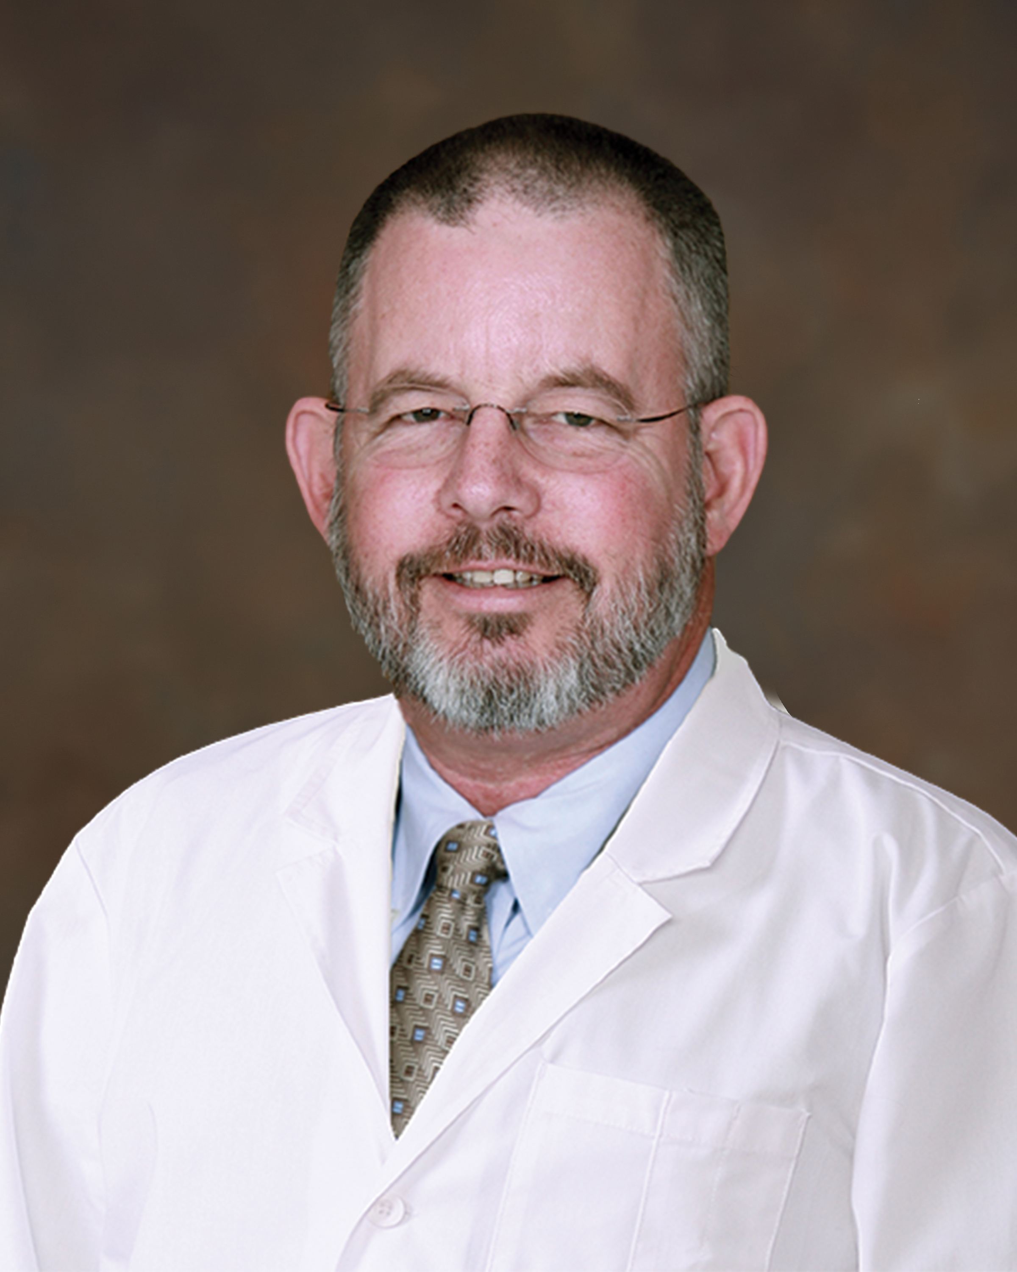
PANEL MEMBER
Dr. Thomas John Hegarty
Dr. Thomas Hegarty is a radiation oncologist at Heartland Cancer Center of Great Bend. A radiation oncologist is a specialized doctor that takes the equivalent of sunbeam (photons, electrons and sometimes protons) and shapes a beam, passing it through the body to hit and treat cancer. Dr. Hegarty has been in the field of radiation oncology for over 30 years.

Slide 26
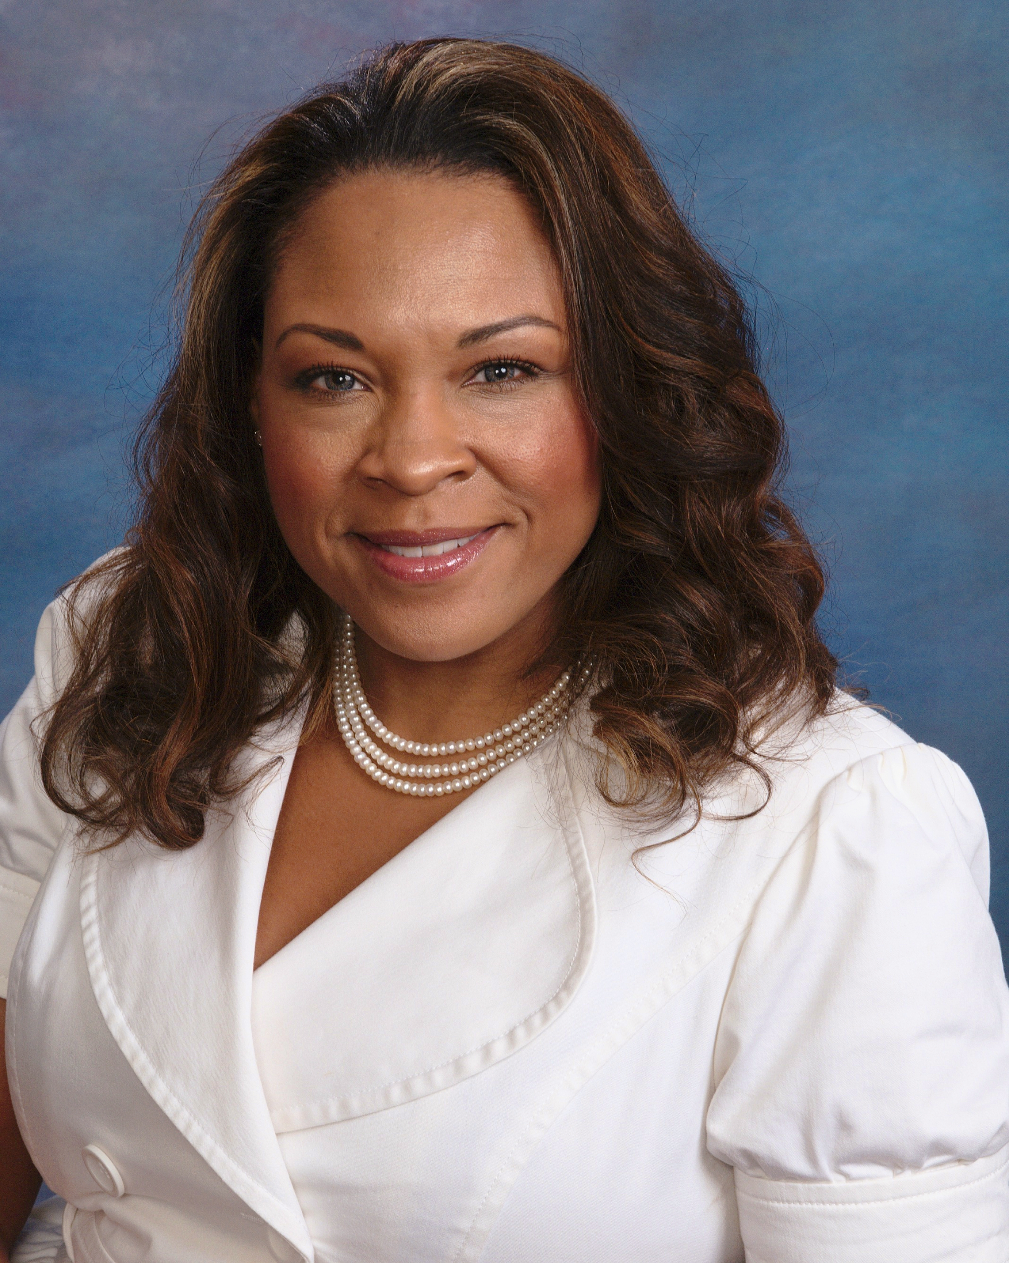
PANEL MEMBER
Dr. Aisha Rush
Dr. Rush is an OB/GYN with the Heartland Regional Health Clinic, located on the 2nd floor of Great Bend Regional Hospital. She and her family are originally from Ann Arbor, Michigan. She prides herself in taking care of the "whole" patient and practices with the bio/psycho/social model in mind. She lives here in Great Bend with her husband and six children.

Slide 27
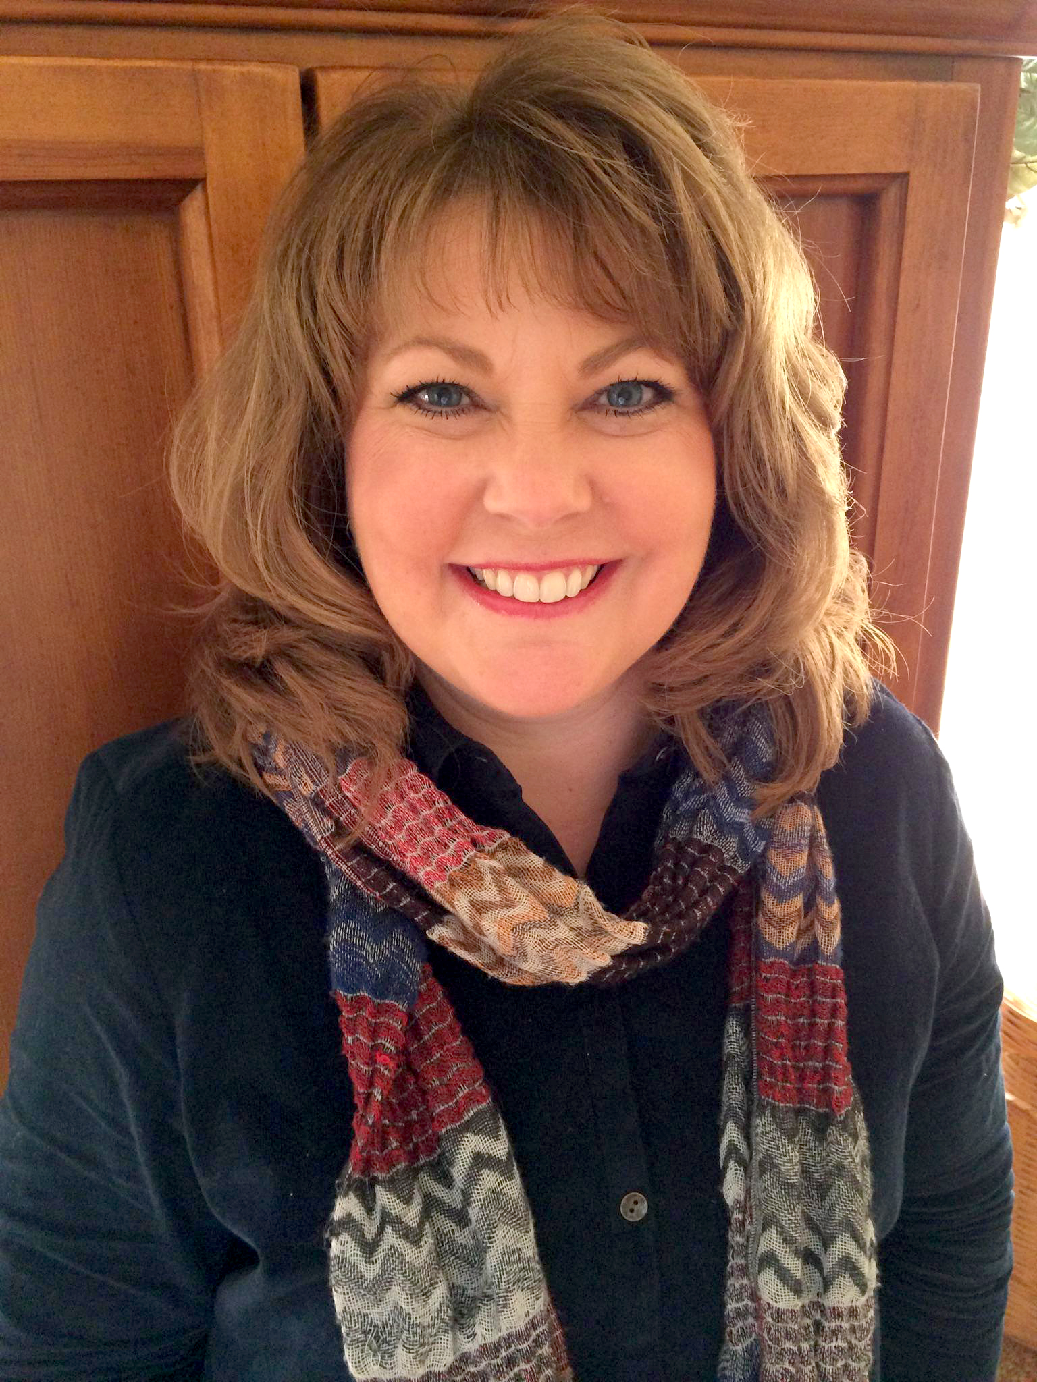
PANEL MEMBER
Shelly Schneider, RN
Shelly Schneider is the Director of Public Health for Barton County. She earned a nursing degree from Fort Hays State University, and has worked in several settings including hospitals, home health agencies, private pediatric practices, and now in public health. She has been with Barton County since 2014, and is an advocate for vaccination and disease prevention. Shelly is married to her husband, Keith, and they live on a farm with their two teenage daughters.

Slide 28
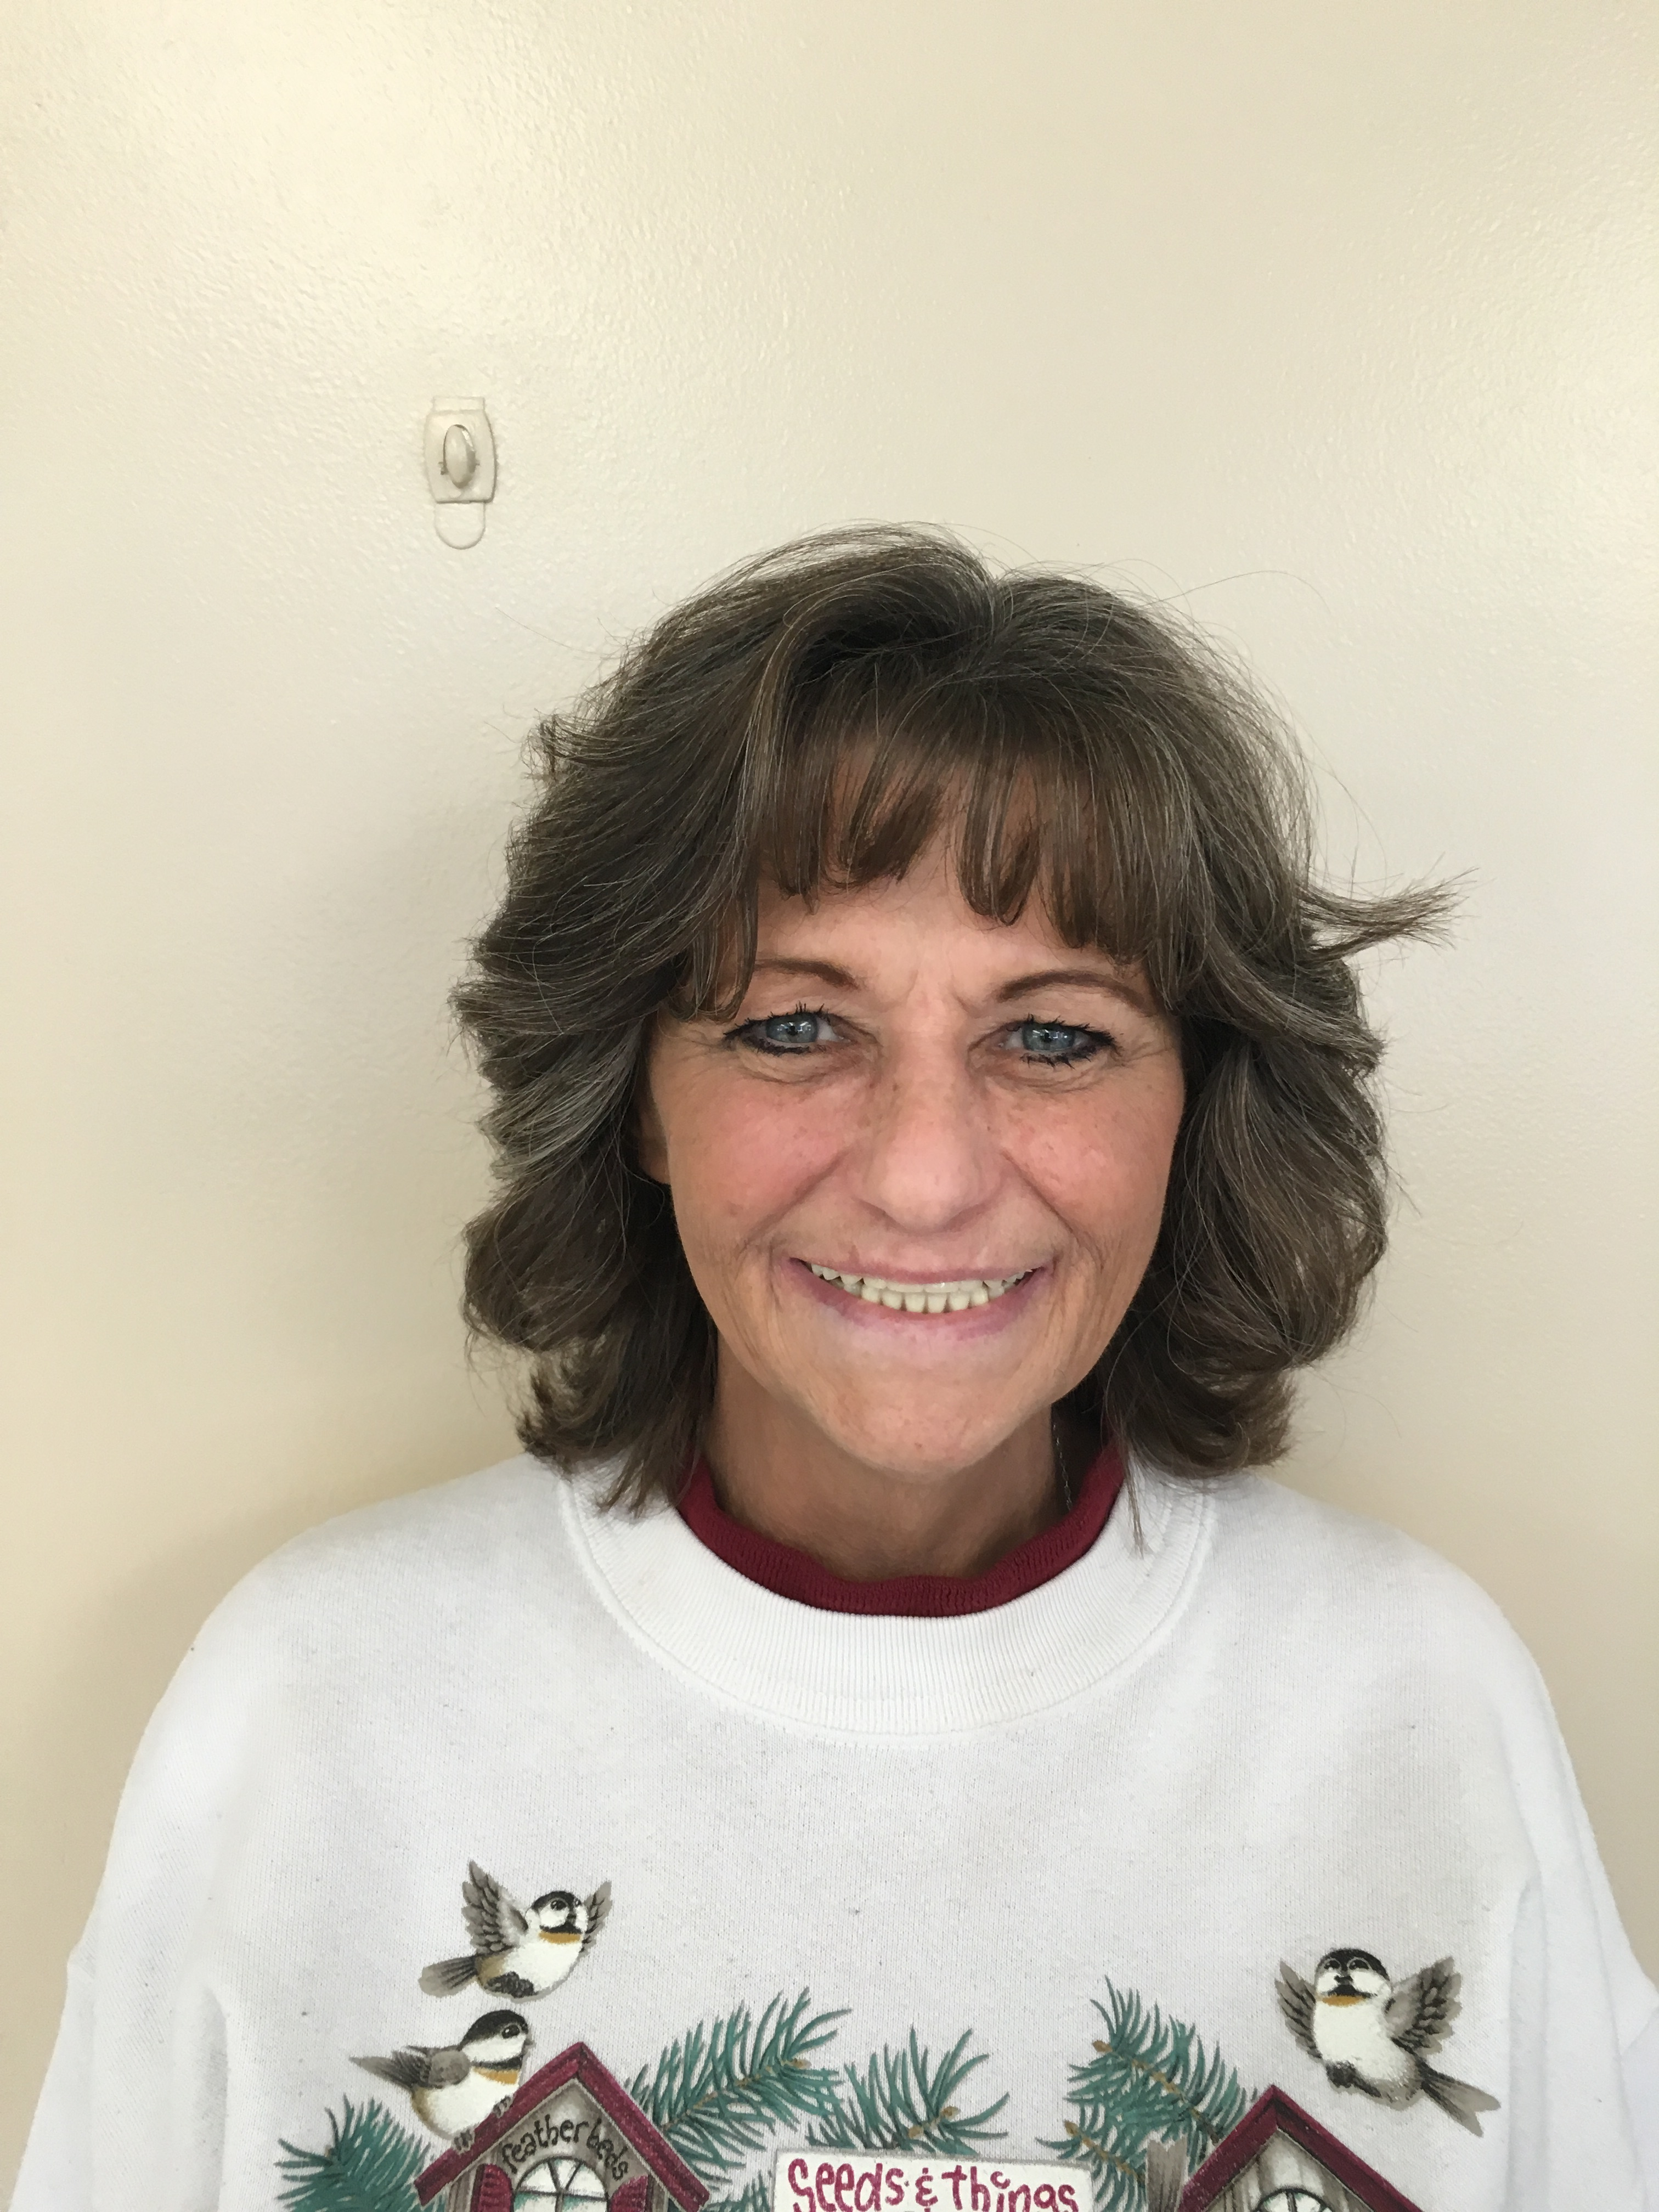
PANEL MEMBER
Susan Pfannenstiel, Survivor
Susan was diagnosed with Stage 4 cancer of the right tonsil from HPV at the age of 53. She had surgery to remove her tonsil, she got a port-a-cath, and feeding tube. She underwent chemo and radiation together, finishing in January 2014. She is doing well now, 2 years later. She is 75 pounds lighter than when she started. She would have had the vaccine and encourages other to do the same.

Slide 29
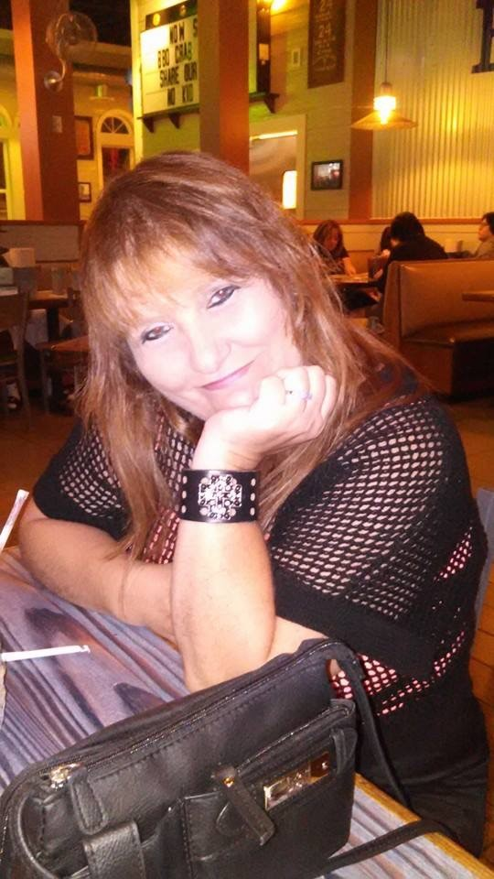
PANEL MEMBER
Sharilyn Collins, Survivor
Shari was diagnosed in 2009 at the age of 41. with Cervical Cancer, HPV positive. She was treated with radiation and chemotherapy. In 2011, the disease reoccurred with evidence of metastasis treated with extensive surgery. She is now 49 years old. Shari recommends the HPV vaccine to prevent what she went through.

Slide 30
SURVEY
http://bit.do/HPVafter

Slide 31
Q&A – PANEL MEMBERS
Dr. Tom Hegarty
Dr. Aisha Rush
Shelly Schneider
Susan Pfannenstiel
Sharilyn
Collins

Slide 32
SURVEY RESULTS

